Slide 1
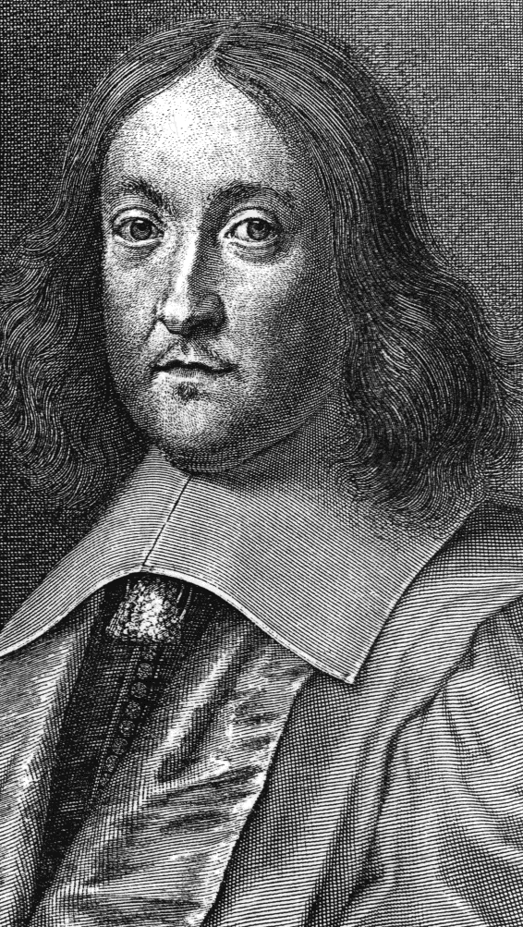
Prediction of Lin28a binding motifs by using 1D-CNN
Song In Wook
Song In Wook
Laboratory of Development and Disease Modeling

Slide 2
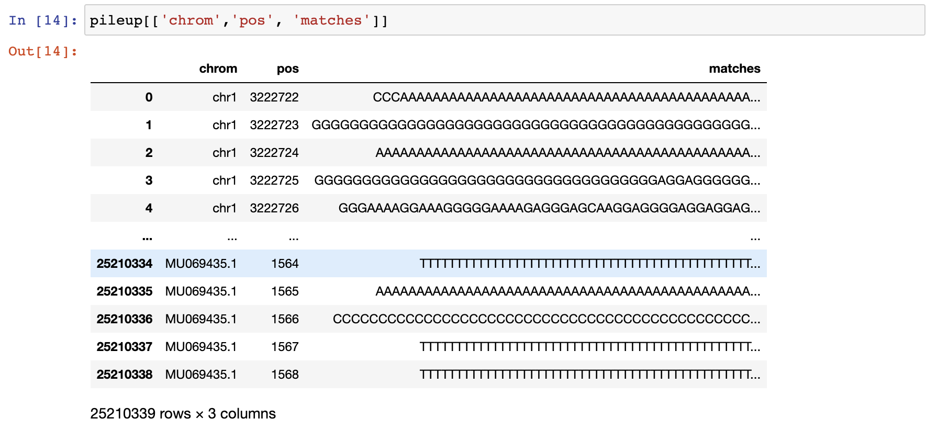
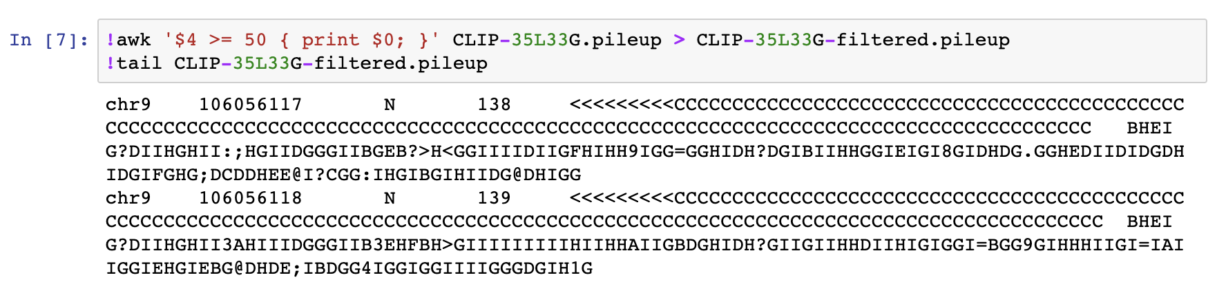
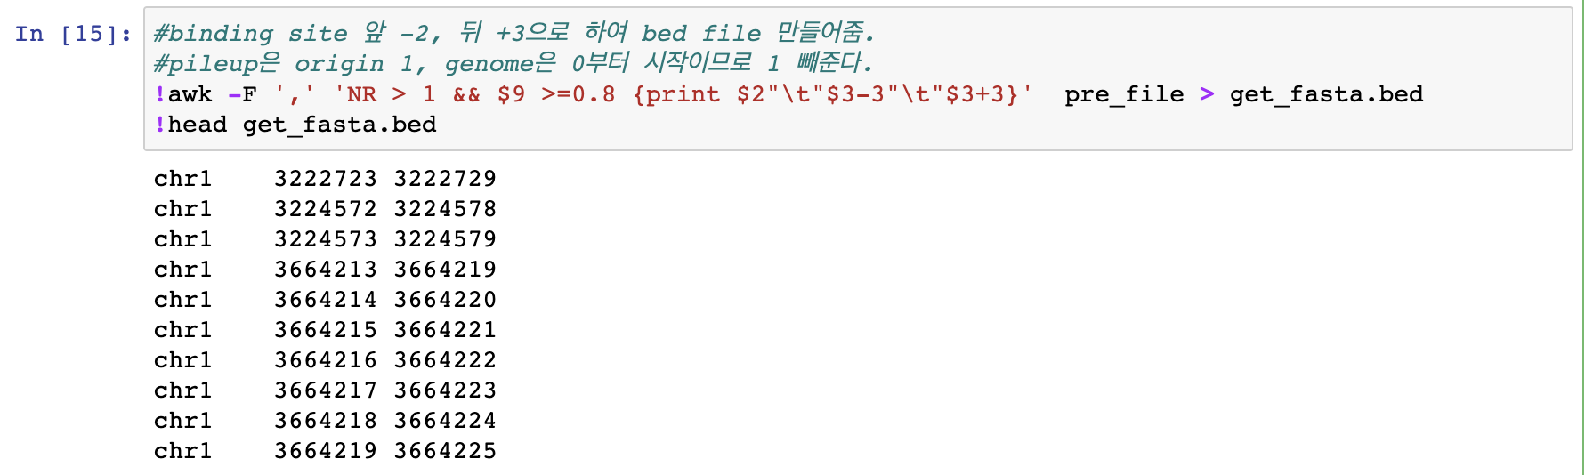
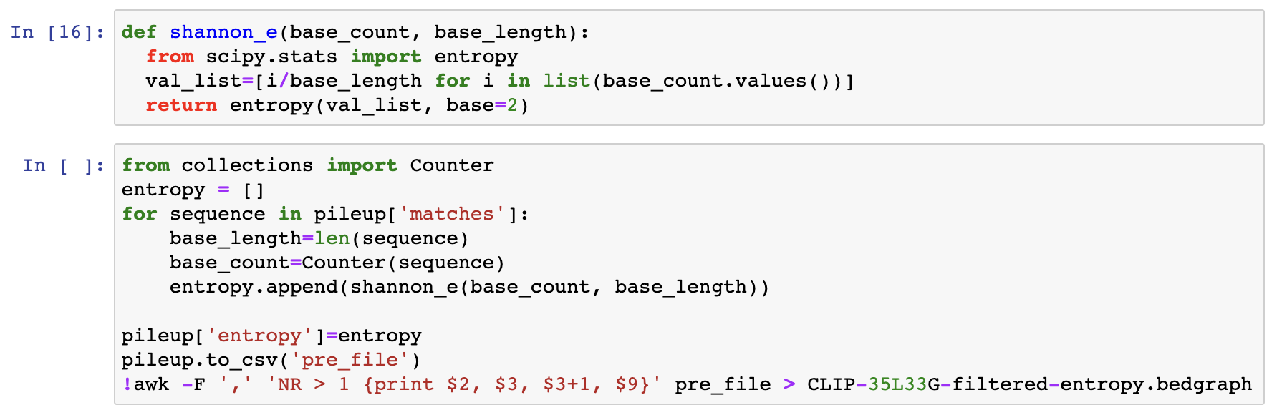
Extract Motifs from MM9 genome
Song In Wook
#1. Pile-up and filtering (for 35L33G and RNA-control)
#2. Removal of characters
#3. Calculation of Entropy for all positions
#4. For entropy >0.8 and =0.0(non binding), extraction of motifs(putative binding, ctrl)

Slide 3
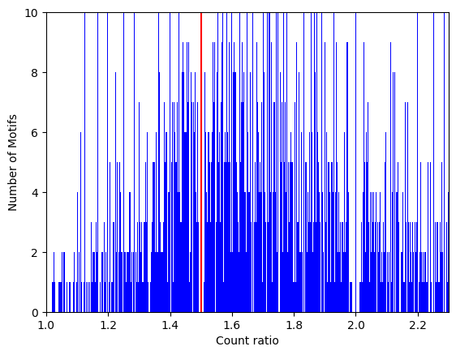
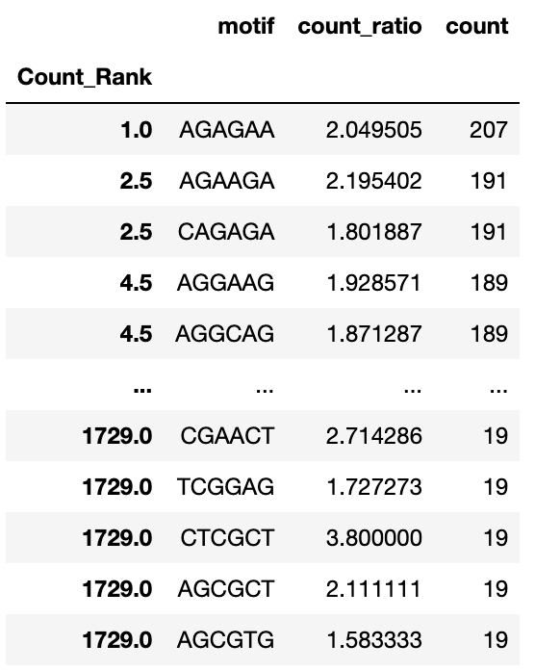
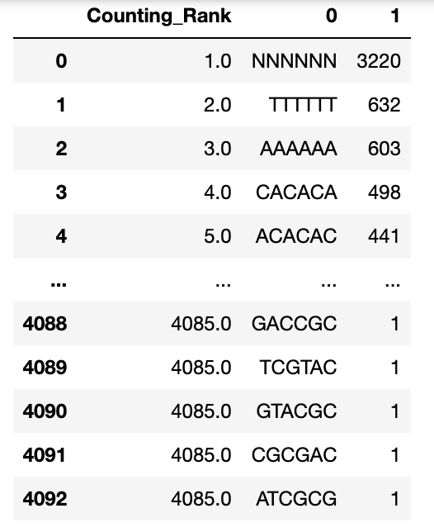
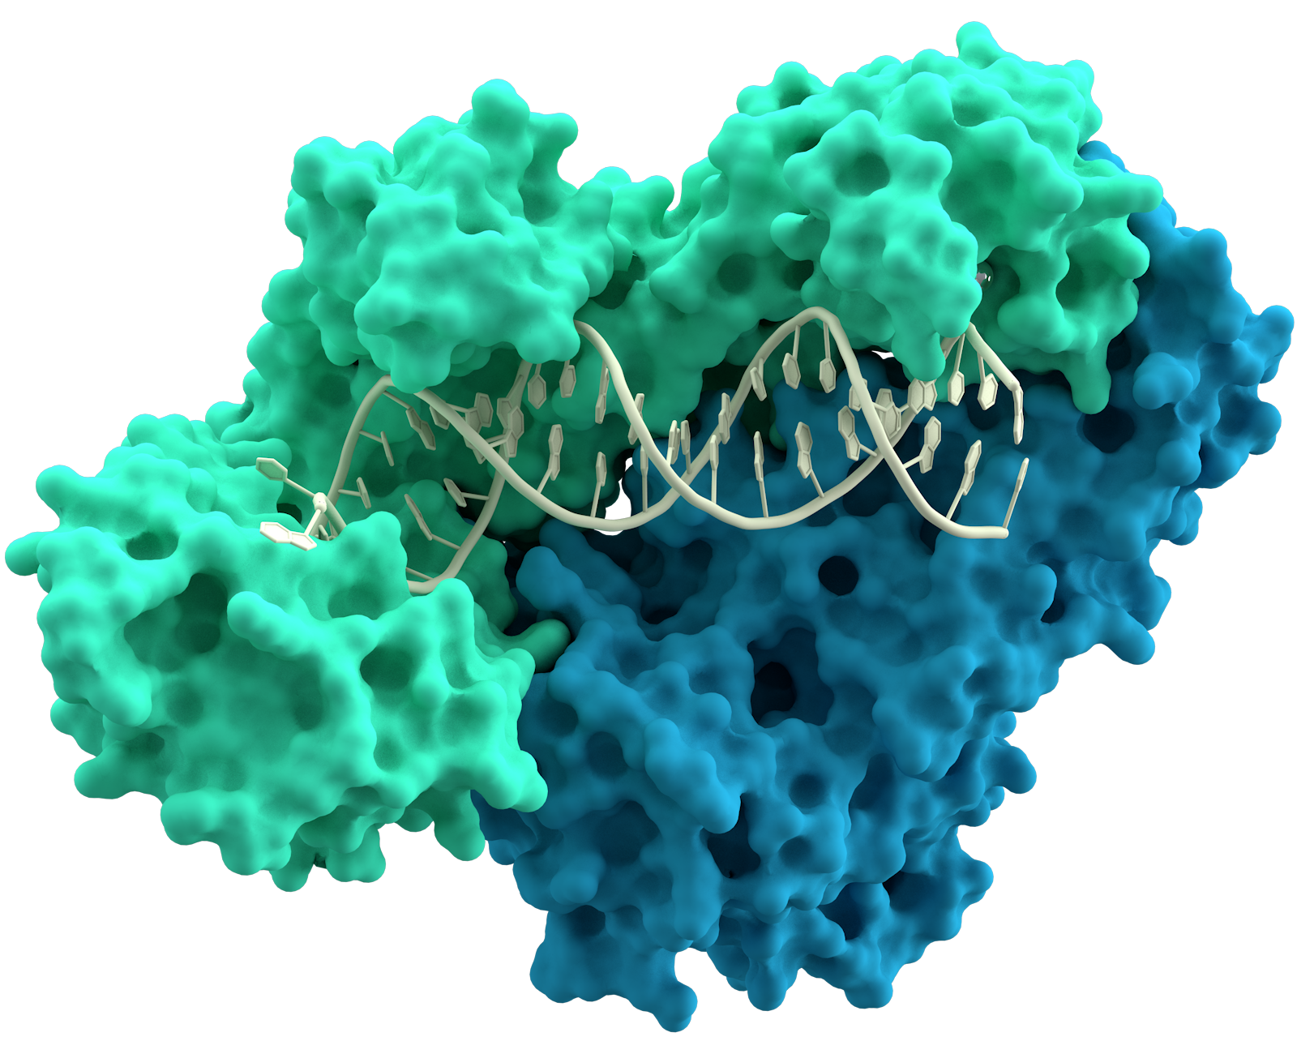
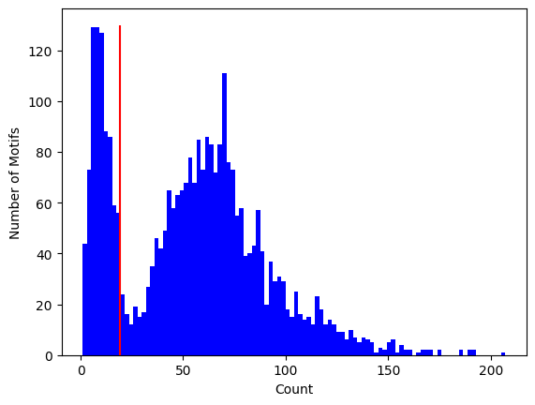
Data Clean-up
Cut-off determination
Song In Wook
1.5(Q1)
Processed
Q. What is the proper “threshold” to determine real motif?
Pre-processed
RT?
Count ratio
19(Q1)
Repeats!
Count

Slide 4
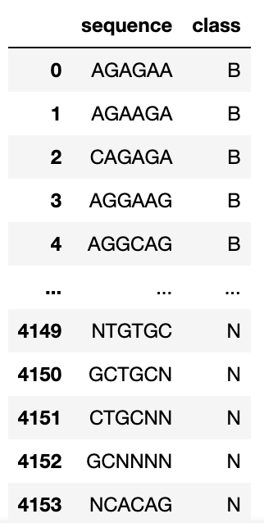
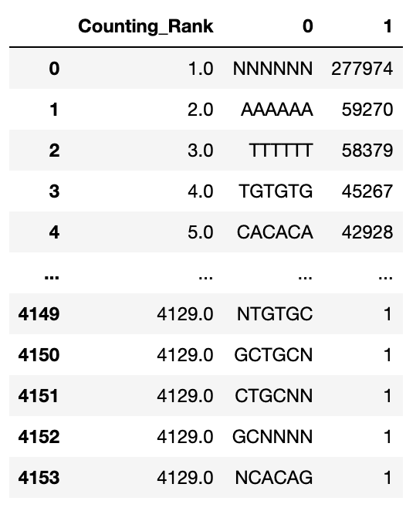
Make categorical data sets for learning
Song In Wook
Q. How can we assign more completely-null groups?
Non-binding(entropy =0)
binding
Binding(B)
1414개
Random = 34%
Non-binding(N)

Slide 5
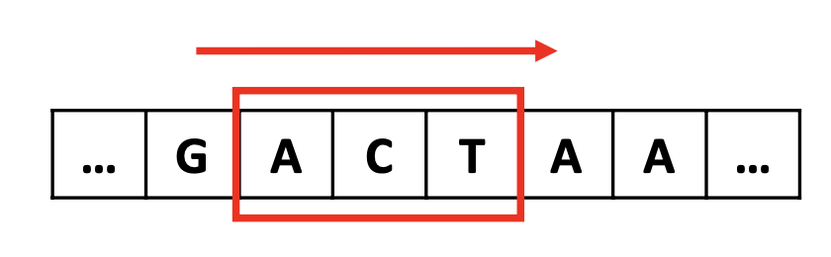
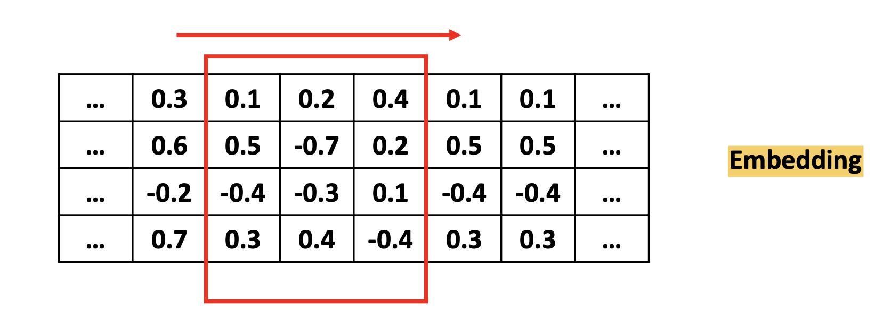
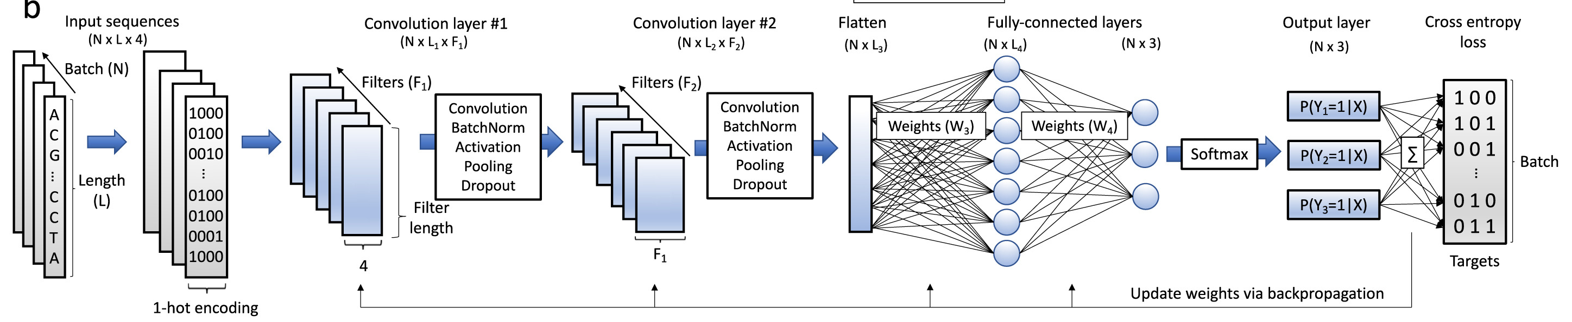
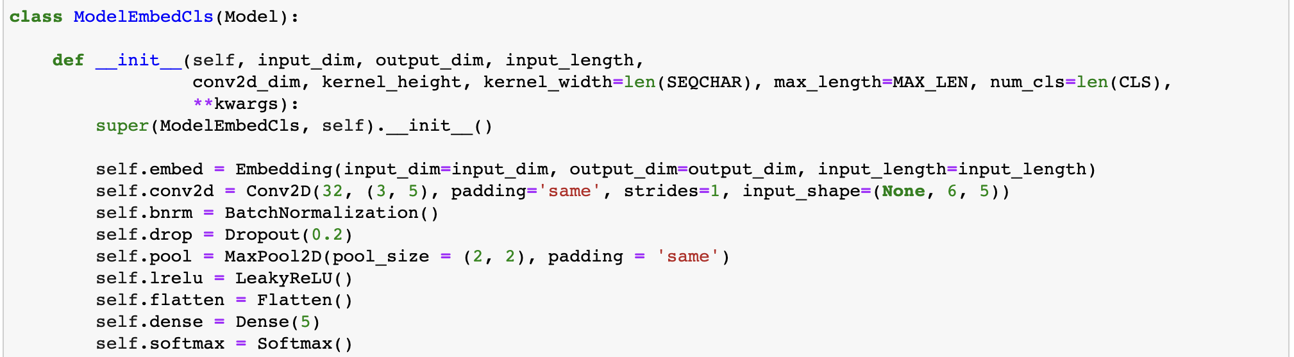
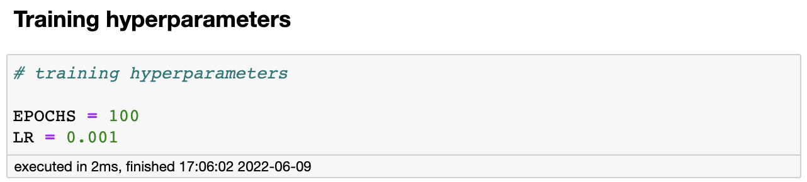
Set 1D-CNN model
Song In Wook
Q. kernel
32
2
2
3-4
5
Due to over-fitting
embedding

Slide 6
Why 1D-CNN model?
Song In Wook
Q. What is the optimal size of kernel? (is there any biological meaning?)
Hypothesis: kernel size [5X1~5X5] -> different accuracy?
32
2
2
3-4
5
Due to over-fitting
embedding

Slide 7
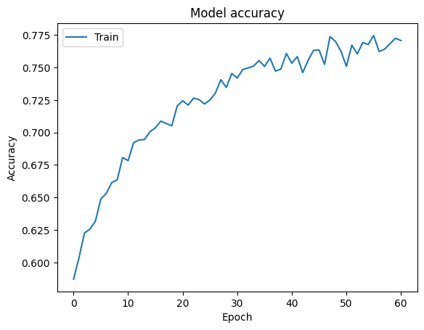
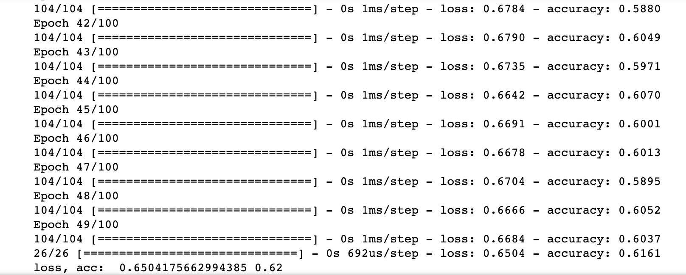
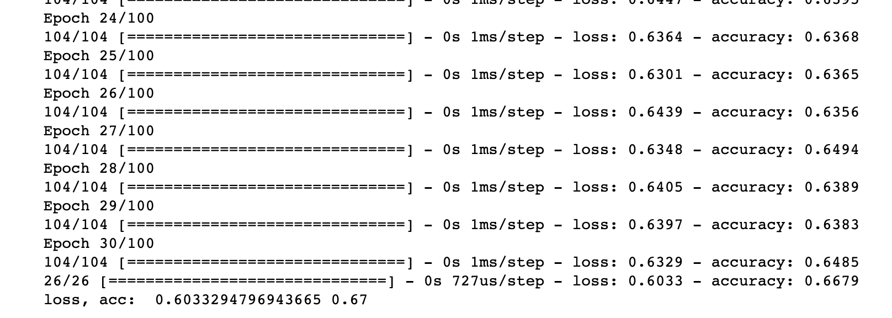
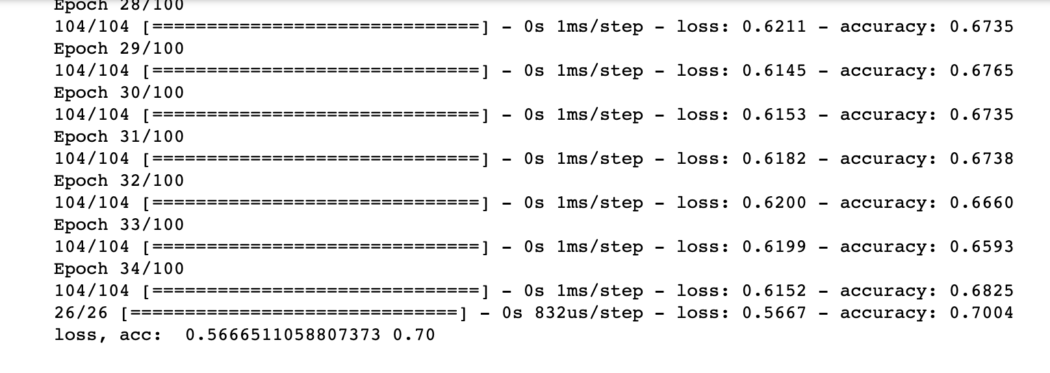
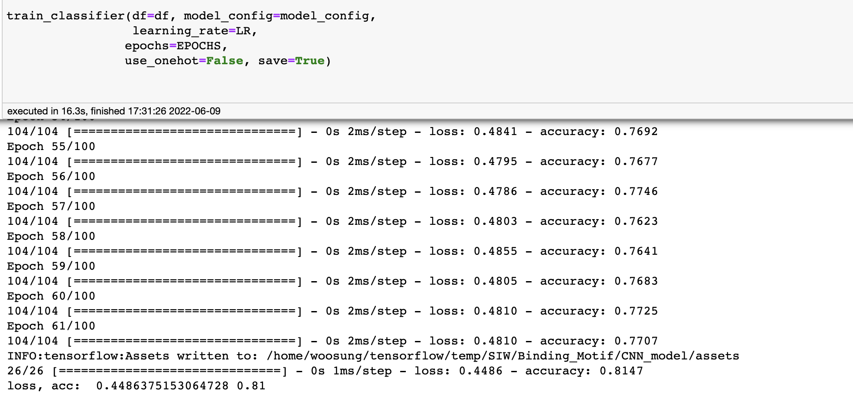
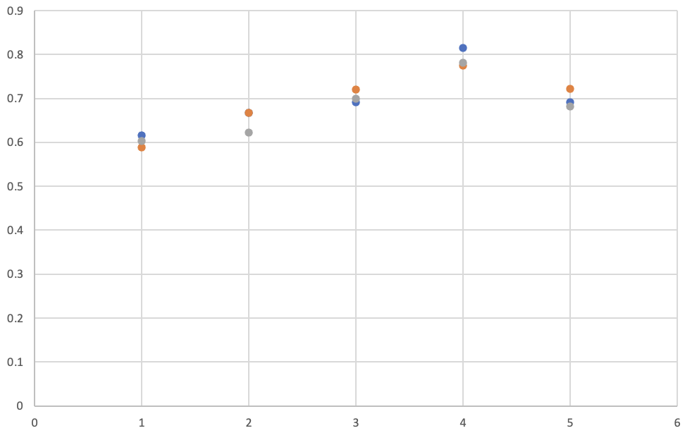
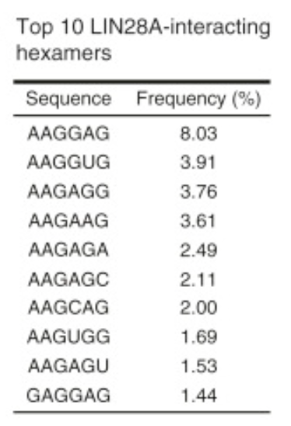
Training and Prediction
Song In Wook
4 is optimal kernel width for prediction of Lin28a binding motifs
1
2
3
4
5
GGAG?
Accuracy
1
2
3
4
5
Cho, Jun, et al. "LIN28A is a suppressor of ER-associated translation in embryonic stem cells." Cell 151.4 (2012): 765-777.
Kernal width

Slide 8
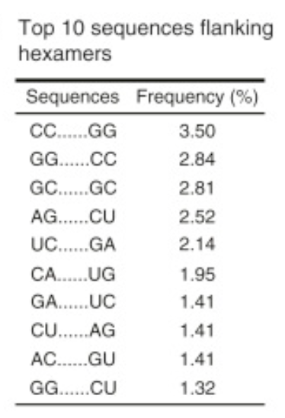
Extra-question. How can we set 1D-CNN model for considering secondary structure? (Ad-Hoc..)
Song In Wook
Original seq
Permutated seq
Original seq
flattening + MLP
convolution
activation + pooling +...
Evalutation
Permutation + branched CNN
[x1, x2, x3, x4, x5, x6]
-> [x1, x6, x2, x5, x3, x4]
Cho, Jun, et al. "LIN28A is a suppressor of ER-associated translation in embryonic stem cells." Cell 151.4 (2012): 765-777.

